Slide 1
Drug Abuse: 1. Reasons and Repercussions 2. Types of Drugs 3. Signs & Symptoms 4. Ill Effects of Drugs and Alcohol 5. Treatment Aspects 6. Prevention
Dr. Chawnglungmuana
CEO, SHALOM

Slide 2
Available Statistics : Substance Use
National Family Health Survey 2015-16
Tobacco use: Men-80.4%, Women-59.2%
Consume Alcohol: Men-49.6%, Women-5.0%
Baseline Survey on Extent and Pattern of Drug Use in Mizoram 2017
(2633 respondents who use drugs)
Tobacco use – 96%
Alcohol use – 90.7%
Cannabis use – 56.6%
Pharmaceutical Opioids use – 69.8%
Sedatives use – 56.8%
Heroin use – 65.8%

Slide 3
Available Statistics : Substance Use
Age of Drugs Initiation (median):
Tobacco and Volatile Solvents : 15 yrs
Alcohol : 16 yrs
Other Oral drugs: 17-19 yrs
Switch to Injectible drugs: 19 yrs
Heroin: 21 yrs
Out of those who use alcohol, 85.6% started using during MLTP era.

Slide 4
Magnitude of Substance Use in India 2019: MSJE
Alcohol:
Use: India (14.6%). Mizoram is 27th Position (7.8%). N-E state zingah Meghalaya chauh kan hnuaiah an awm.
Zu khapna state (Gujarat, Bihar, Manipur, Nagaland etc) ah zu in tlem deuh mahse zu vanga buai enkawl ngai an tam thung.
Dependence: India (2.7%), Mizoram (1.1%). N-E State zingah kan hniam ber.
Opioid Use: India ramah ngawlvei %age kan sang ber.
Sedative Use: A sang pali hi N-E states; Mizoram 4th
Cannabis Use: N-E state tam zawk chu India average aiin kan sang vek.
Drug dependence treatment dawng – 25%

Slide 5
Ruihhlo hmansual kailawn
Zuk leh hmuam ti lo
1st Level-Khawtlang pawm – Tobacco, Paan, Gutkha
ATS – Methamphetamine
2nd Level-Khawtlang pawm loh – Zu, damdawi (zawrh), Ganja, Hip chi (Dendrite)
3rd Level-Khawtlang pawm loh (inchiu chi) – Heroin, Proxyvon, Parvon Spas
ATS – Methamphetamine

Slide 6
Stages of Substance Use
Non-Use
Experimental Use
Occasional Use
Regular Use
Abuse/Misuse
Dependency (Addiction)

Slide 7
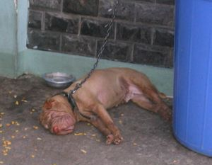
Ruihhlo Ngawlveina
Ruihhlo Ngawlvei (Addict) Vs Ruihhlo Hmangsual (Abuse)
Sual (Sin) Vs Disease (Natna) concept
Ngawlveina ah chuan heng hi a awm ngei ngei –
Withdrawal (chiri)
Craving (chak huam huam)
Tolerance (damdawi mamawh zat tam tial tial)
Harmful use (harsatna thlen mahse hmang lo thei lo)

Slide 8
Drug Addiction (Dependency) Ruihhlo ngawlveina chu enge?
Definition of Addiction (Hrilhfiahna): Drug addiction is a “chronic relapsing brain disorder” (Ruihhlo ngawlveina hi thluak natna benvawn, lo lang chhuak leh thin a ni)

Slide 9
Definition of Substances (Psychoactive Substances) -RUIHHLO:
Any substances which can cause:
Sensory Distortion (hear, sees, smells, taste etc.);
Mood changes;
Change in Cognition (thought process);
Behaviour; and
Motor functions
These substances can either be licit (legal) or illicit (illegal)
Can result in Dependence

Slide 10
Types of Drugs
Depressants: Drugs that reduce functional or nervous activity
Alcohol
Opioid Drugs (Heroin, Codeine, Morphine, Tramadol etc)
Benzodiazepines (Diazepam, Alprazolam, Nitrazepam etc)
Antispasmodic drugs (e.g. Cataspa, Spasmolar etc)
Volatile solvents
Cannabis
Stimulants: Drugs that raises physiological or nervous activity
Nicotine
Caffeine
Cocaine
Amphetamine type stimulants (ATS)
Cannabis
Hallucinogens: Drugs that can cause hallucinations
LSD
PCP
Volatile Solvents
Cannabis

Slide 11
Signs of Drug Abuse
Thiante leh chhungte lak atanga inlak hranna
Thian kawm thinte thlak
Zirna lamah tlahniam
Ngui leh zawi emaw, thinrim thut thut
Pawisa puk ching thar
Dawt sawi an ching thar
Ruihhlo tam zawk an hman sual hi chuan a tirah phurna (euphoria) a thlen.
Insumtheihna an tlachham
Mood swing – rilru sukthlek inthlak thut thut
Ei leh in inthlak – ei hunbi mumal lo, hmawmsawm uar thar
Mut hunbi mumal lo
Bathroom ah hun an hmang rei

Slide 12
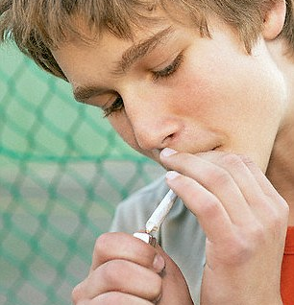
Ruihhlo Tih Chhan
Thian hnai/hmelhriat ngaihsan te tih dan tih chak ve na (Peer Influence)
Hriat/tih chhin chak ve hrim hrim (Curiosity)
Hlauhawm tih hre chung pawha han tem ve chakna (Risk-taking)
Thiante tih zawng tih ve loh nuam ti lo (Peer Pressure)
Mental disorder

Slide 13
Ruihhlo vanga harsatna
Hriselna a khawih pawi
Communicable diseases
General ill-health
Mental Disorder
Nitin nunah harsatna
Isolation, academic, social stigma
Dan bawhchhiatna
Accidents, violence, crime
Sum leh pai harsatna

Slide 14
Ruihhlo hmansual nghawng
Jail tang 40-50% vel hi ruihhlo leh a kaihhnawih.
Rehab home a enkawl ngai tam ber
27% of HIV+ hi Infected needles/ syringe atanga kai.
80-90% of IDU - Hepatitis C reactive.
Accident a thlen tam.

Slide 15
Drug Abuse/ Addiction Treatment

Slide 16
Management
Kan hriat tak angin Ruihhlo khawih an nih a, a ngawl an la vei loh chuan ngawlvei lo tura venhim vat an mamawh.
Ngawlvei an nih tawh chuan Professional Help an mamawh a, refer ngei tur a ni.
Taksa, rilru leh thlarau nun thlenga khawih buai thei anih vangin a chikim a enkawl an mamawh.
Treatment Helps

Slide 17
Drug Addiction Treatment
Pharmacotherapy
Psychotherapy
Rehab Services

Slide 18
Drug Addiction Treatment
Pharmacotherapy:
Detoxification, management of withdrawals
Management of Co-morbidities (damlohna/natna hrang hrang an neih te eg. Hepatitis B/C, HIV, other medical problem, mental disorder)
Psychotherapy:
1-to-1 counseling, Group Counseling, Self awareness, Alcoholic or Narcotic Anonymous (AA/NA)
Behavioural therapy
Rehab Services – After care, Rehab Home, Home treatment
Harm Reduction – hri tha lo an kai loh nana venhimna (syringe exchange, safe injection practices)

Slide 19
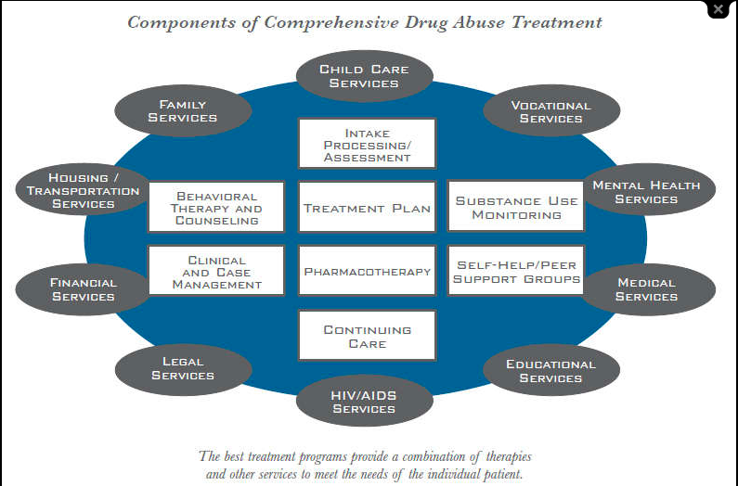

Slide 20
Drug Abuse/Addiction Prevention
Who to prevent? Tunge kan ven tur?
Naupang – Engtin?
Tleirawl – Engtin?
Nula/Tlangval – Engtin?
Puitling – Engtin?
How to prevent? Engtinnge kan ven ang?
Govt sector: Education, END, Police, Social Welfare, Health
Private Sector: YMA, Kohhran
Who should prevent? Tunge veng ang?

Slide 21
Prevention Tips
Naupang tirh chungchang:
Zuk leh hmuam lei tura tirh
Damdawi lei tura tirh
Naupang/tleirawl derthawng bik hriat tum
Nu leh Pa te sawi pui
Encourage discussion of topics (misconception & myths - hriat dan dik lo ti dik turin)
Non-judgement attitude
Refer na tur hriat
Thian sual kawm lo tura zirtir aiin anmahni thian tha ni tura zirtir

Slide 22
About Alcohol
Zu bik hi a ruih leh ngawlvei dan chu drugs dang nen in ang mahse a enkawl dan a hrang hlak a ni.
Mipa aiin hmeichhia in an zo lo hma, an taksa pawh a khawih chhe hma.
Mithiamte sawi danah chuan mipa tan ni khatah 160-180 ml hi taksa huat loh tawk a ni. Hmeichhia ah 120 ml.
Withdrawal (chiri) hi medical emergency a ni. Damdawiin a enkawl ngai a ni.
Zu in danah him lo ber te chu zing zu in leh kawruak a tak deuh in thin hi ani.

