Slide 1
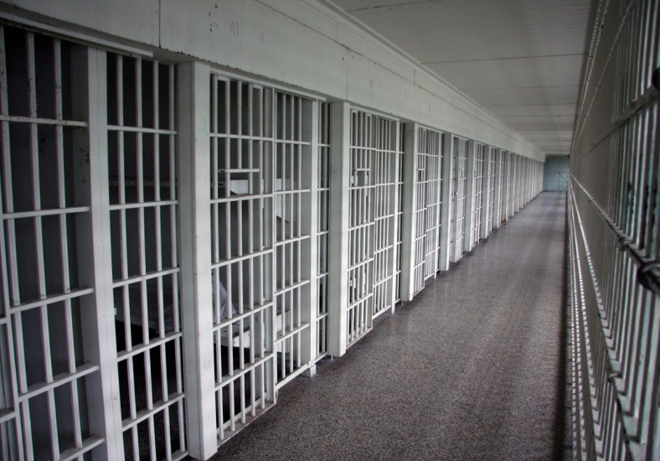
TREATMENT & COUNSELLING OF PRISIONERS FOR DE-ADDICTION & PREVENTION

Slide 2
DAMAGE DUE TO ADDICTION:
Physical deterioration
Psychiatric problems
Intellectual impairment
Personality deterioration
Safety risks – accidents and high risk behaviour
Legal risks

Slide 3
PRISON PROFILE: CENTRAL JAIL
compiled by SHALOM through Project Sunrise - since 2016
Total no. of inmates registered (till March, 2019)
= 1127 (M-977, F-150)
No. of imprisonment:-
Once/First Time - M-55.5% F- 65.3%
Two Times - M-22.2% F -20.6%
Three Times or more- M-22.3% F-14.1%
10 Times or more - M-19 inmates

Slide 4
Reason for imprisonment (excluding serious ones – murder, rape, etc.):-
Drug use related - M-9.1% F-13.3%
Selling drugs - M-11.1% F-38.6%
Theft - M-23.8% F-11.3%
Antisocial activities- M-41.3% F-28.6%

Slide 5
TREATMENT:-
Drug addiction treatment can include:-
Behavioural therapy (e.g. counselling, psychotherapy)
Medications
Case management and referral to other medical, psychological, and social services.

Slide 6
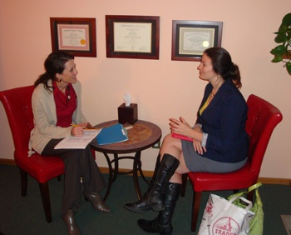

Slide 7
COUNSELLING:-
A process of supporting a person to learn how to solve emotional, interpersonal & decision-making problems – thinlung leh rilru na , midang nena inkungkaihna chungchanga harsatna, mahni inrin tawk lohna nei te chhawmdawlna atana hmanrua.
Helping clients to help themselves – clients te mahni ngei a an chetchhuah theihna tur a tanpui
Can be done with individuals/ couples/ families/ groups - mimal/ nupa/ chhungkua/ pawl ah

Slide 8
Specific to the needs, issues& circumstances of each client – a hman dan chu mimal mamawh dan ah, an harsatna ah leh dinhmun ah a innghat
An interactive, collaborative & mutually respectful process – inpawhna leh inzahtawnna boruak a tangrual taka hmalak
Goal directed – tih tur/ tum nei
Oriented towards developing autonomy, self-responsibility & confidence in clients – clients te mahni kea din, mawhphurhna hriat leh inrintawkna nei tura chher
Sensitive to the socio-cultural context – mimal dinhmun leh hnam zia ngaihchan leh dah pawimawh

Slide 9
4 key skills of counseling:-
Listening skills.
Verbal skills.
Non verbal skills.
Feedback.

Slide 10
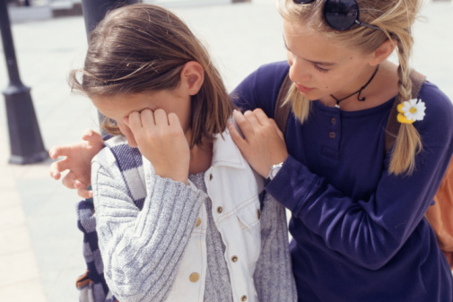
Role of the Prison officials:-
Understanding the disease concept
Empathy
Honesty/Loyalty
Ownership feeling
Observation skills

Slide 11
Central Jail staffs:-
Special Superintendent - 1
Jailer - 2
Asst. Jailer - 2
Chief Head Warder - 2
Head Warder - 16
Warder - 73
UDC - 1
LDC - 1
Driver - 1

Slide 12
Peon - 1
Barber - 1
Sweeper - 4
Staff Nurse - 2
Head Pharmacist - 1
District Jail:-
Superintendent - 1
Asst. Jailer - 1
Head Warder - 4

Slide 13
Warder - 25
LDC - 2
Driver - 1
Peon - 1
Staff Nurse - 2

Slide 14
WHOLE PERSON RECOVERY:-
Enkawlna tha tak dawn leh ruihhlo tih chhunzawm loh hi DAMNA a ni mai em?
A tawi thei ang berin WPR chu Damna tluantling ruihhlo laka fihlim(drug free), Dan bawhchhiatna leh thil thalo tih laka fihlim(crime free) leh mahni inchawmzo nun( gainfully employed) ani a tih theih awm e.

Slide 15
Damna hi enkawlna pek lai leh pek zawh veleh emaw a lo thleng nghal thuai a ni lo.
Tha thlah lova tan leh midang te puihna dawng zel chunga beih a ngai.
Ngaihsual palh awl tak chu ruihhlo ber an lo nghei tawh chuan damna an lo chang chho zel tur a ngaihna hi a ni.
Harsatna hre ringawta chumi beih chuan si loh chuan awmzia a nei hek lo.
Damna chu nun dan thar a ni. Nghei/sim ringawt a ni lo, ngaihdan/rilru lo thar, nungchang leh midangte nena inlaichinna leh hun hman dan te thleng hian a danglam a ngai.
Damna tlo leh tluantling nei tur chuan mahni intodelh a pawimawh hle a ni.

Slide 16
Mawhphurhna tak tak chu ruihhlongaiah a in nghat ber.
A tumruhna mai bakah, mithiamte puihna, chhungte inpekna leh a thiante amah pui thei tu leh SHG / NA / AA te an pawimawh bawk.
Midangte puihna hian awmze thui tak an dam zel nan a nei a ni.
Rilru, nungchang, midangte nena inlaichinna lam leh nunphunga harsatna awm hrang hrang te sutkian a ngai a, heng hi ruihhlo nghei nen thil awlsam tak a ni lo.
Mahse, WPR atan chuan a tul si.

